Slide 1
IDS PROJECT
By
Krupakar
Chirag
Shashank

Slide 2
Overview
Data Cleaning
Normalization and Standardization
Graph Visualization
Hypothesis Testing
Correlation

Slide 3
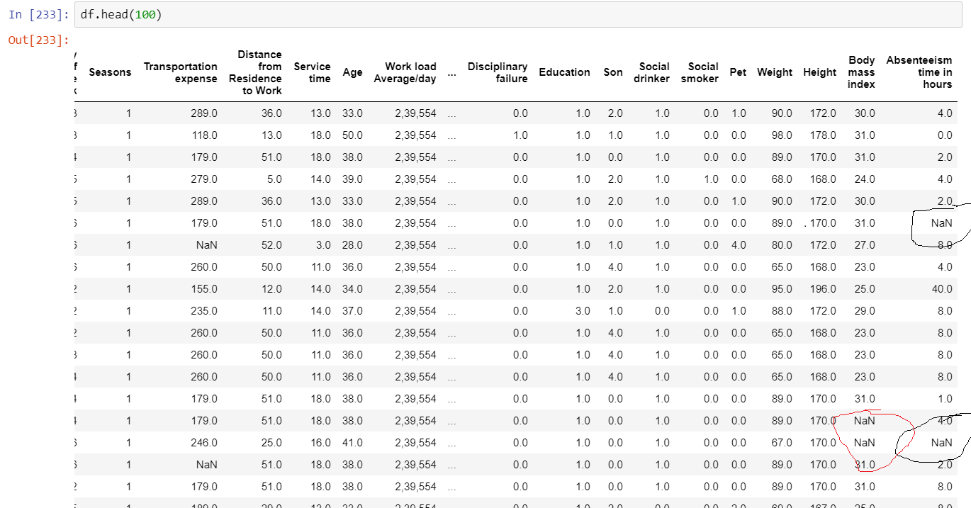
Data Cleaning - Before Cleaning

Slide 4
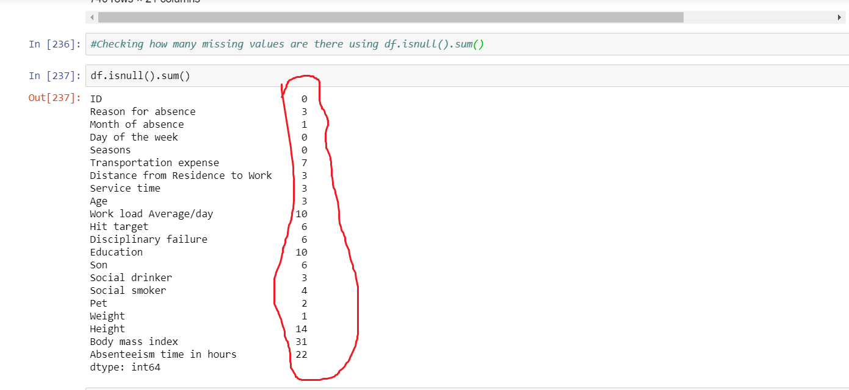
Data Cleaning
Before Cleaning

Slide 5
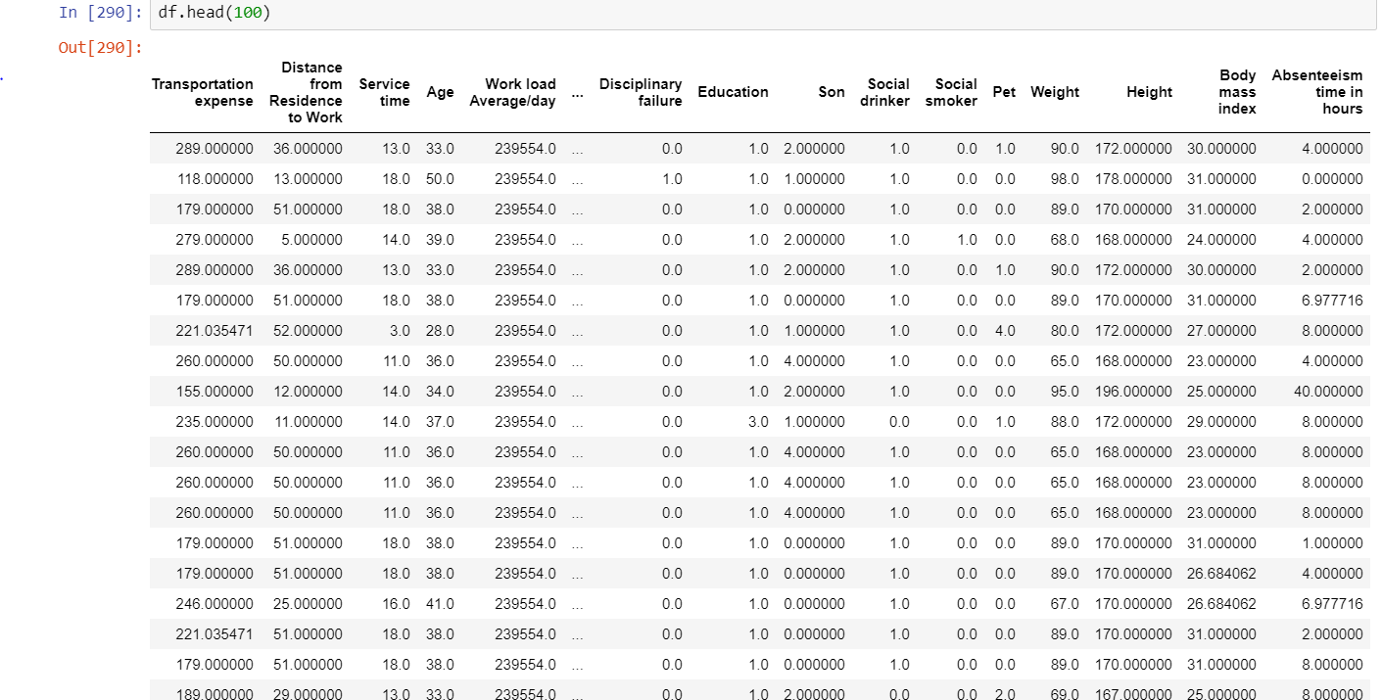
Data Cleaning - After Cleaning

Slide 6
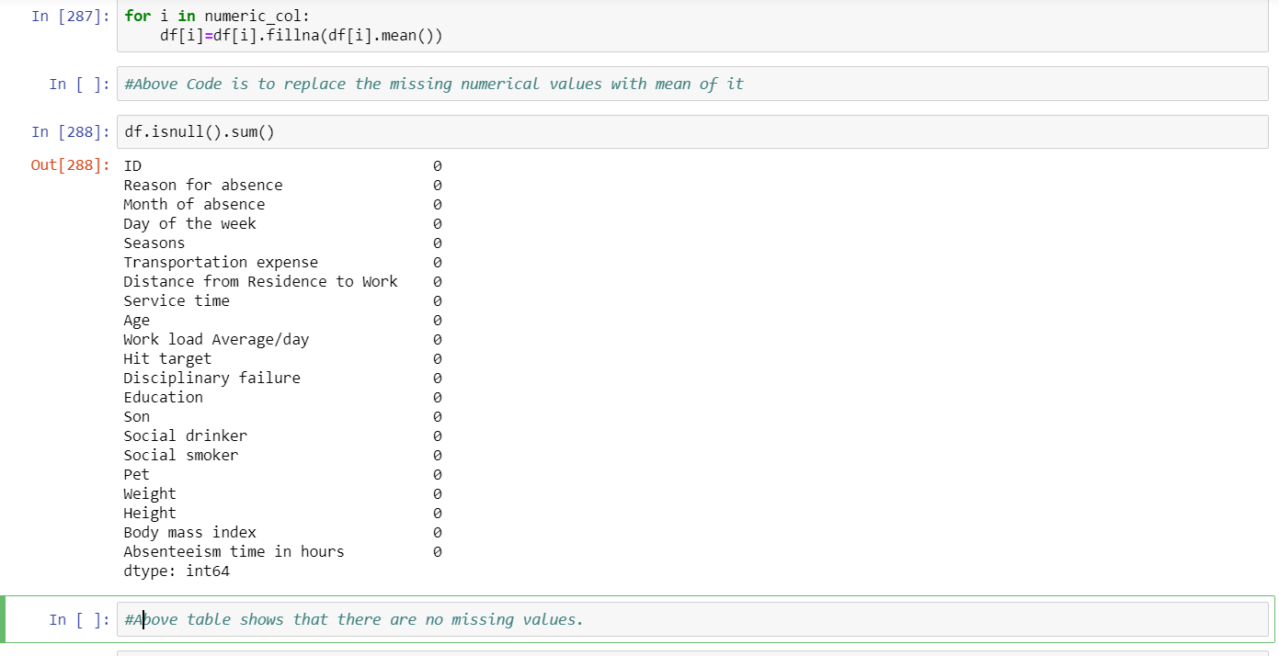
Data Cleaning
After Cleaning

Slide 7
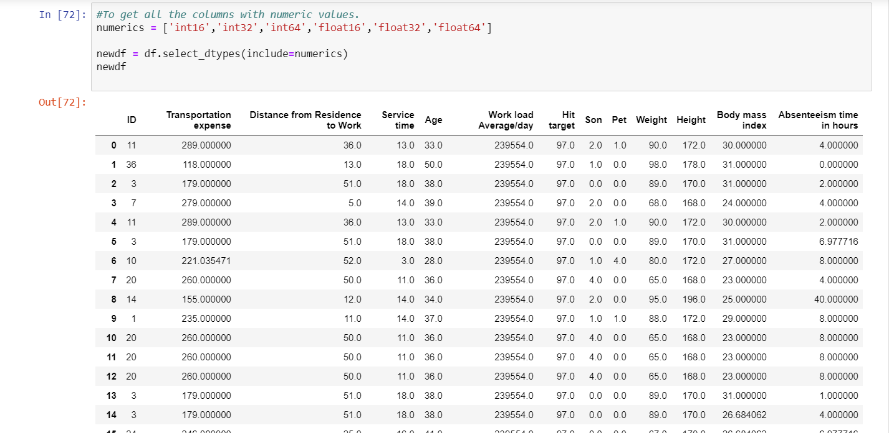
Normalization and Standardization
The goal
of data
normalization
is to reduce
and even
eliminate data redundancy

Slide 8
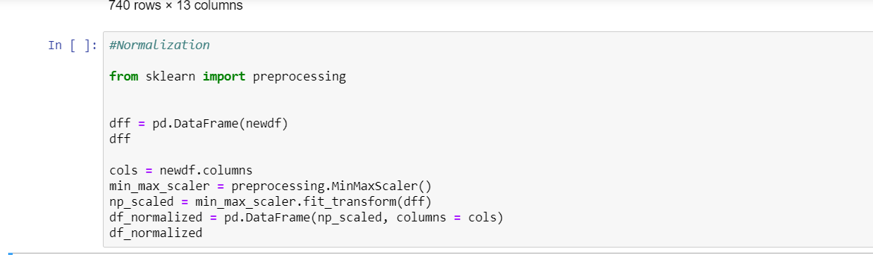
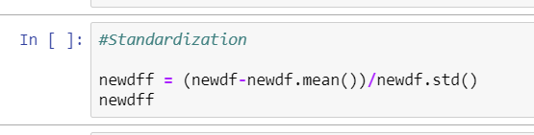
Normalization and Standardization

Slide 9
Importance of Normalization
The goal of data normalization is to reduce and even eliminate data redundancy
Normalization is to change the values of numeric columns in the dataset to a common scale, without distorting differences in the ranges of values

Slide 10
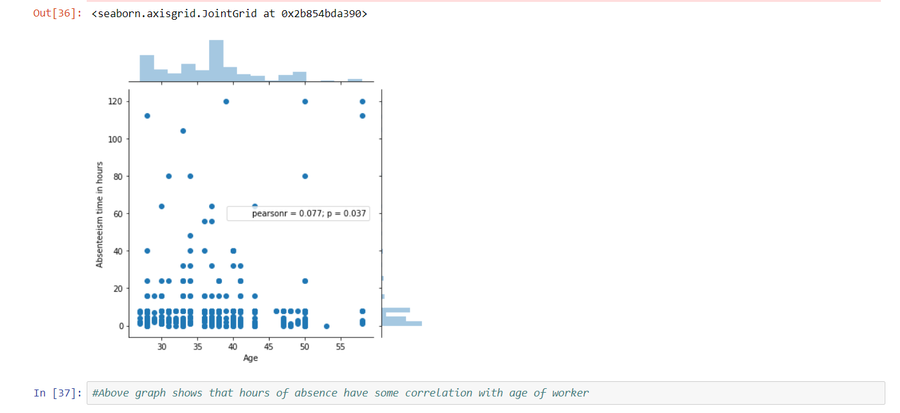
Graph Visualization
Absenteeism VS Age

Slide 11
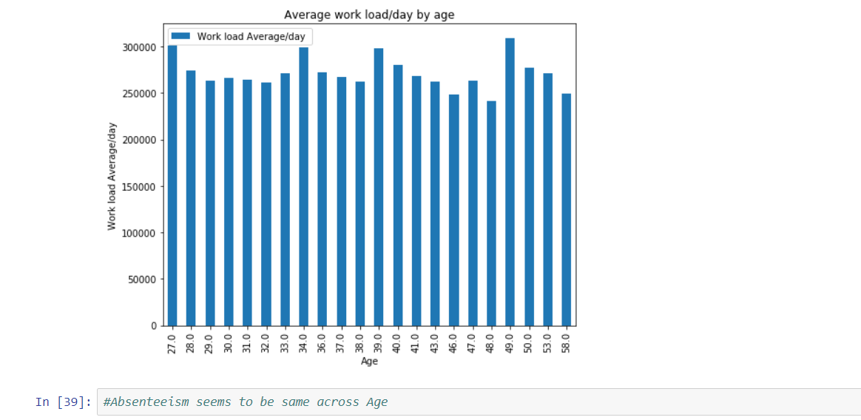
Graph Visualization
Work Load VS Age

Slide 12
Hypothesis Testing
As our Dataset contains ‘Distance to work’ , ‘Pet’ and ‘Son’ Columns.
It’s time for making an Hypothesis.
1st Hypothesis
HYPOTHESES : ‘Distance to work’ increases the absenteeism hours.
2nd Hypothesis
HYPOTHESIS : The More children an employee has, its more likely to remain absent for that employee (As he would be completely engrossed in handling them.)

Slide 13
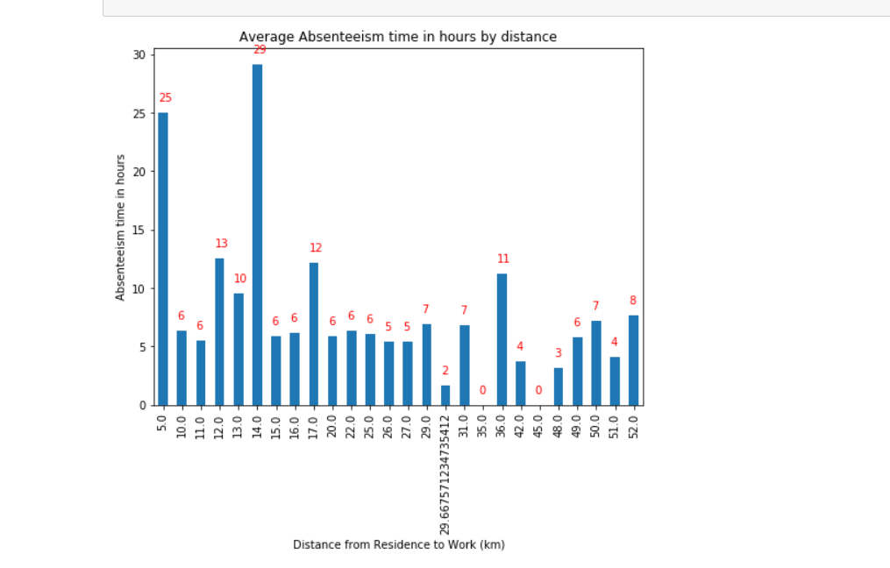
Hypothesis Testing
Distance VS Absenteeism Hours

Slide 14
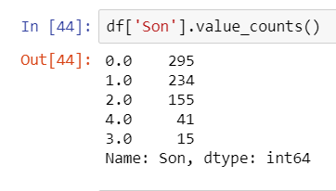
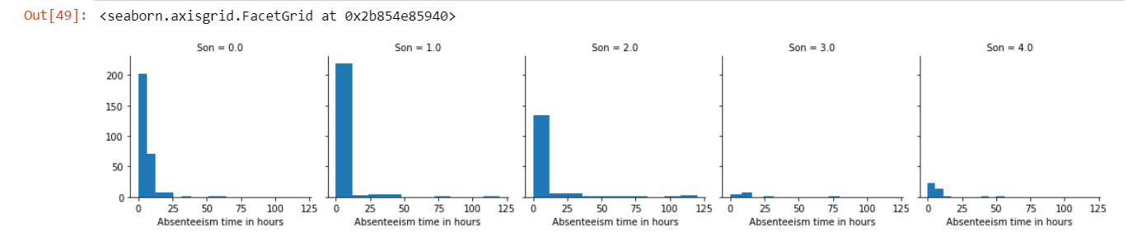
Hypothesis Testing
Sons VS Absenteeism Hours

Slide 15
Hypothesis Testing
Both the Hypotheses are proved Wrong.
From the Distance VS Absenteeism Hours Graph, 1st Hypothesis is proved wrong
From Sons VS Absenteeism Hours Graph, 2nd Hypothesis is proved Wrong

Slide 16
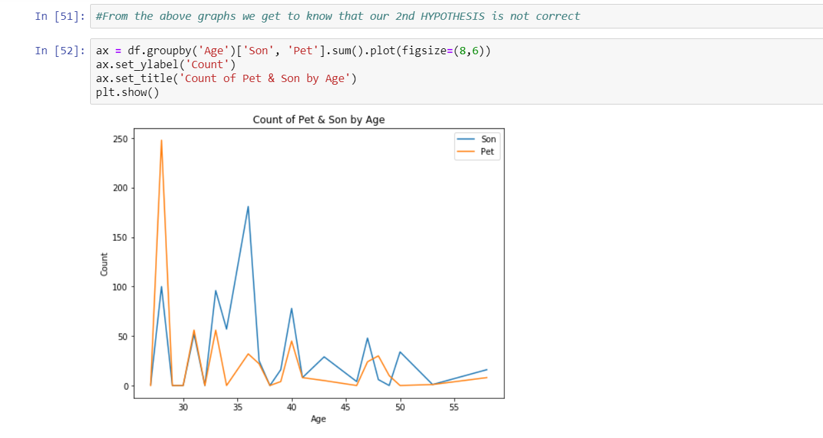
Hypothesis Testing
Count VS Age
The graph
shows that the
employees who
have many
Sons are mostly
having a pet.

Slide 17
Hypothesis Testing
All possible options for 'Son' column are shown in their correlation with absence time. We can see that, if you have 1 or 2 children, it is more likely to be absent at work.
More children you have, less time you are absent. It means, that they can basically watch each other or play with the pets and you don’t need to stay at home to take care of them.

Slide 18
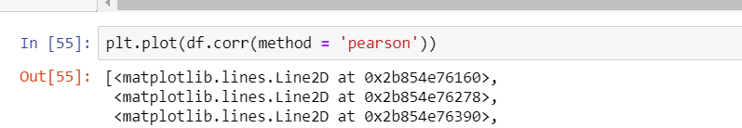
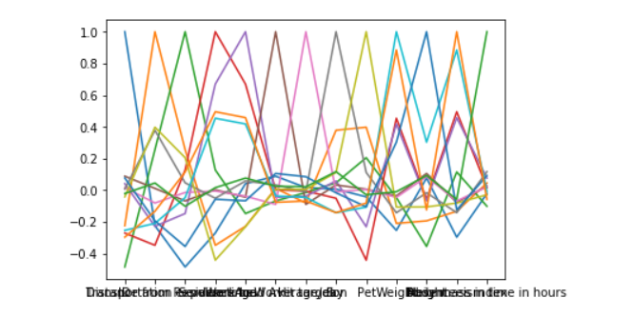
Correlation

Slide 19
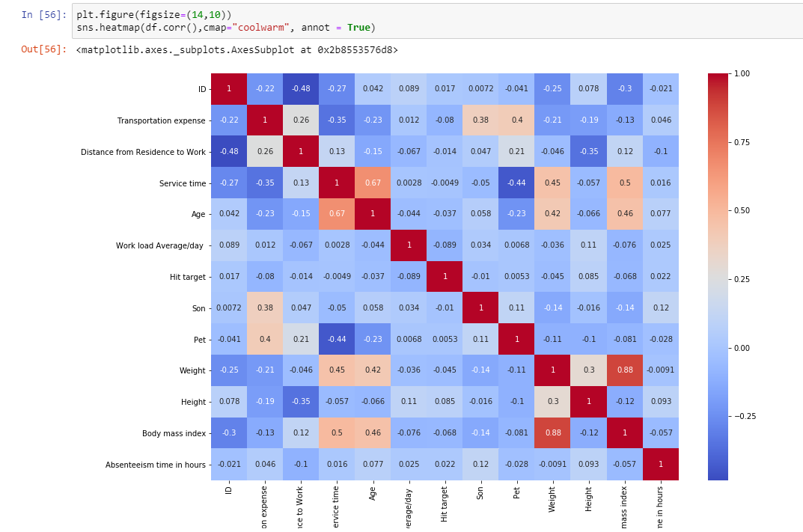
Correlation
Insights from Graph
The less BMI, the more
they are likely to be absent.
The less pets they have,
the more they are fond
of being absent.

Slide 20
Thank You

